Slide 1

Sentiment Analysis

Slide 2
Why Sentiment Analysis!
Provides subjective analysis
BusinessWeek Survey 2009, 70% of people consult online reviews and ratings to make a purchase
Comscore/The Kelsey group 2007, 97% of the people found online reviews to be honest

Slide 3
Subjective vs Objective Analysis
Objective Analysis
Language identification
Text categorization
Sentiment Analysis
Emotion analysis
Trend analysis
Danger analysis

Slide 4
Data Sources
Social Media Websites
facebook, twitter …
Blogs
Forums
E-commerce Websites
Amazon, yelp, download …
Professional Review websites
Dpreview, zdet, consumerreview, epinions, bizrate, imdb …

Slide 5
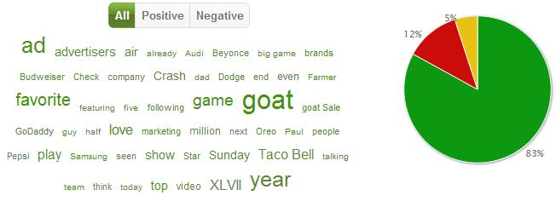


Out-come of Sentiment Analysis

